Slide 1
LC vs DDS: PR 101 for Libraries
Stacey Wacknov
Sway Communications, LLC
With Jennifer Burke of IntelliCraft Research LLC – host of Marketing Tool Talk
Notes:
Brief intro/bio – who am I?

Slide 2
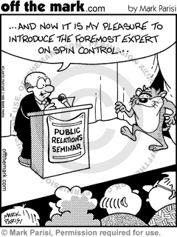
Why Are We Here?
LC
  Lacking Concern
    “Everyone loves libraries – we don’t need PR.”
    “Everyone SHOULD love libraries – we are an essential part of the community.”
DDS
  Doing it Differently for SUCCESS
Notes:
Ask to write down/send to Jenn: Why should the media want to pay attention to my library?

Slide 3
What Can PR Do For You?
Hint: It’s more than press releases – PR is foundational and holistic
Reputation building/maintenance
Thought leadership
Drive traffic
Grow audience size/appeal
Provide rationale and passion to increase grants/donations
Employee loyalty and “living the mission”
Every employee and customer touchpoint should be part of your PR/marketing plan
Notes:
“What do you do?” story
Research shows that credibility and reputation are as important (sometimes more so) than product, service and support – think about your own experiences and when you’ve “cut some slack” on a poor product or service misstep because your overall experience with that business is top-notch

Slide 4

Do Your Homework
What we do best: RESEARCH
Goal-setting must be SMART: Specific, Measurable, Actionable, Realistic, Time-bound
  Overarching and for specific programs
SWOT: Strengths, Weaknesses, Opportunities, Threats
  Do you need crisis and scenario planning?
  Know your allies and detractors
  Involve your staff
Goals/objectives vs. strategies vs. tactics
Define your audience(s)
  “Everyone” is not an answer – be specific
Select your spokespeople
Core messages → Supporting messages → Proof points
In short: Plan your PR and reduce reactivity
Notes:
Don’t forget creative programs, alliances – the unusual or heartwarming (or tragedy) will get coverage
So instead of the usual Summer Reading Program announcement…inquire if the mayor (or a local author or other celebrity) would shave his/her head if kids read 20,000 books over the summer…then keep media/influencers posted with a press event at the end
Consider a Blogger Summit to hear what the community needs and/or what they aren’t aware of
What about Bookless Library-to-Go at key locations to showcase online options and classes?

Slide 5
Create Your Toolkit
Press materials
  Fact sheet(s) – statistics, history, “Did You Know?”, myths vs. facts
  Leadership/speaker bios
  Media alerts/pitch emails (subject lines are key)
    Tailor your pitches/messages for each reporter/influencer – know their interests and what will resonate – one size does NOT fit all
  Social media posts
  Press releases…sparingly!
  Make sure you understand internal approval processes/timing
Media/influencers – Relationships are EVERYTHING
  Who is on the beat in your community? (print/online; TV/radio -- traditional and social media/bloggers)
  Influencers are everywhere – government, community leaders, supporters, teachers, parents…
  Industry trades (library and who you serve)
  Friendly neighbors
Notes:
Keep your materials TIGHT, copy-wise – no more than a page or so apiece (social media, even shorter)
If you do social media: WHY? What do you want to achieve? Are certain platforms worth the effort? Can you be responsive?
You are a relationship builder – communication is two-way street, give and take – you are not just producing material for broadcast. It’s a conversation.

Slide 6
I’m ready! Now what?
Be realistic about what you want to achieve – your story is one of hundreds
Never go to traditional media without real news – you need a unique angle/why this is important to your audience(s)
  Watch the news and figure out interesting/unusual entrees
  Be journalists’ allies, not annoyances
  Your goal: Be a reliable, go-to resource -- not a salesperson
Track your results
  Measurement is critical for leadership
  Key learnings after every outreach – worth the time
Stay positive but curious
  Listen to what your audience needs
  Ask media/influencers how you can best serve them
  Be flexible and adjust accordingly

Slide 7
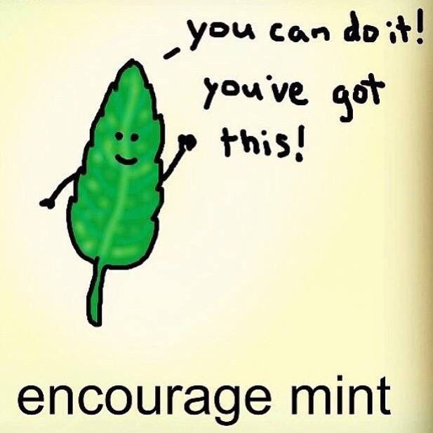
Can You DDS?
If you’re here, you’re already on your way
Be creative
Be strategic
Be willing to take risks
Be reliable
Be on message
BELIEVE!
Notes:
In the beginning, I asked you to write down why the media would want to pay attention to your library. Use that as a starting point. Is it realistic? Is it the real reason – or are there a host of reasons that change for each audience? What would leadership say vs. your customers? How do you answer the REAL call? This is where you begin.

Slide 8
Still need help?
I’m here for you!
Stacey Wacknov
Sway Communications, LLC
917-279-9080
swacknov@gmail.com

